Slide 1


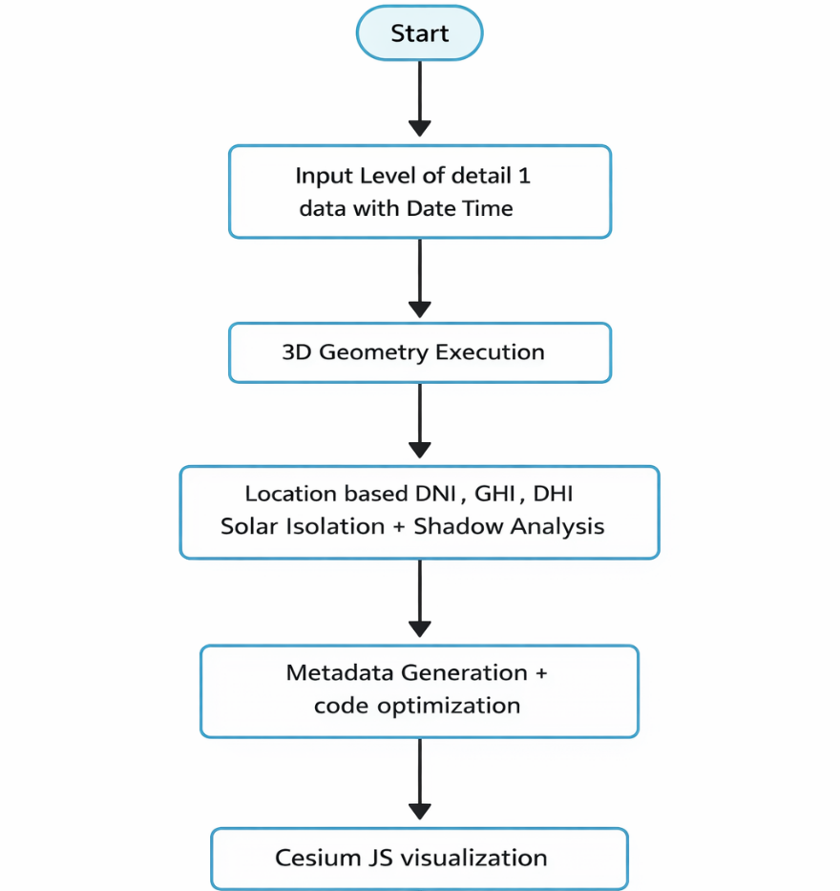
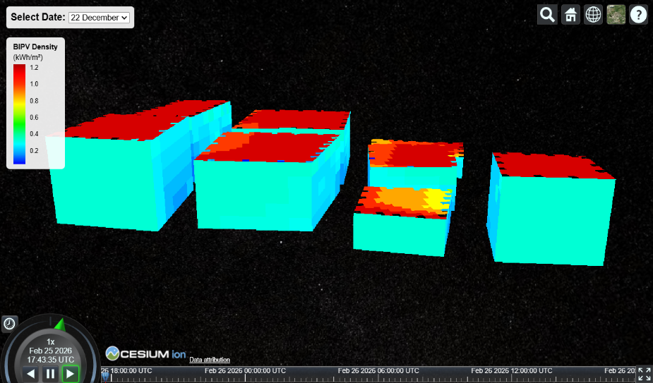
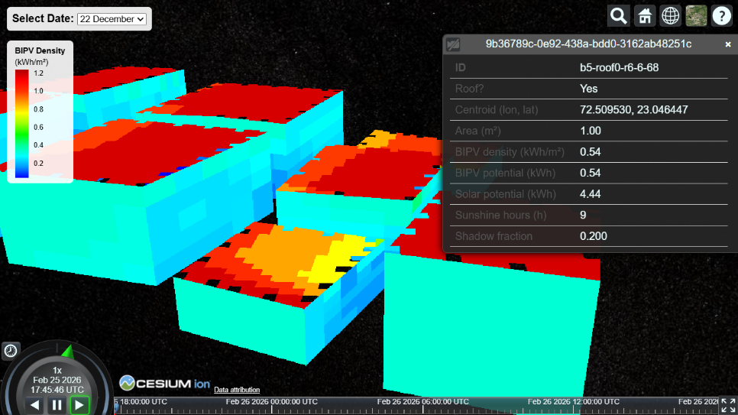
Project Title: 3D Urban Building Energy Assessment for BIPV Applications using Geospatial Techniques
SRTD-RTMG-MISA
Name: Vaibhav Dineshbhai Nai
Designation: Researcher
Institution: Monark University
Guide: SMT. SHWETA MISHRA
Contact e-mail: jaiswals@sac.isro.gov.in
PHOTO
MAJOR OBJECTIVES:
Automated Mesh-to-Metadata Generation for high-resolution BIPV assessment using LOD1 data.
Shadow-Aware BIPV Energy Model using Ray Tracing.
Scalable Urban Solar Data Pipeline with Computational Optimization.
3D JSON Tileset Visualization using CesiumJS with BIPV information.
13 OCT 2025 to
14 FEB 2026
METHODOLOGY FLOW CHART:
RESULTS/MAJOR FINDINGS:
8Buildings in Cesium JS On click Metadata Generation
CONCLUSION:
Built an optimized, shadow-aware 3D urban BIPV assessment system with efficient Metadata mapping. Enabled scalable, facade-level solar analytics in an interactive 3D environment.

